Slide 1

Wedding décor
Kale family

Slide 2
Sangeet Décor

Slide 3
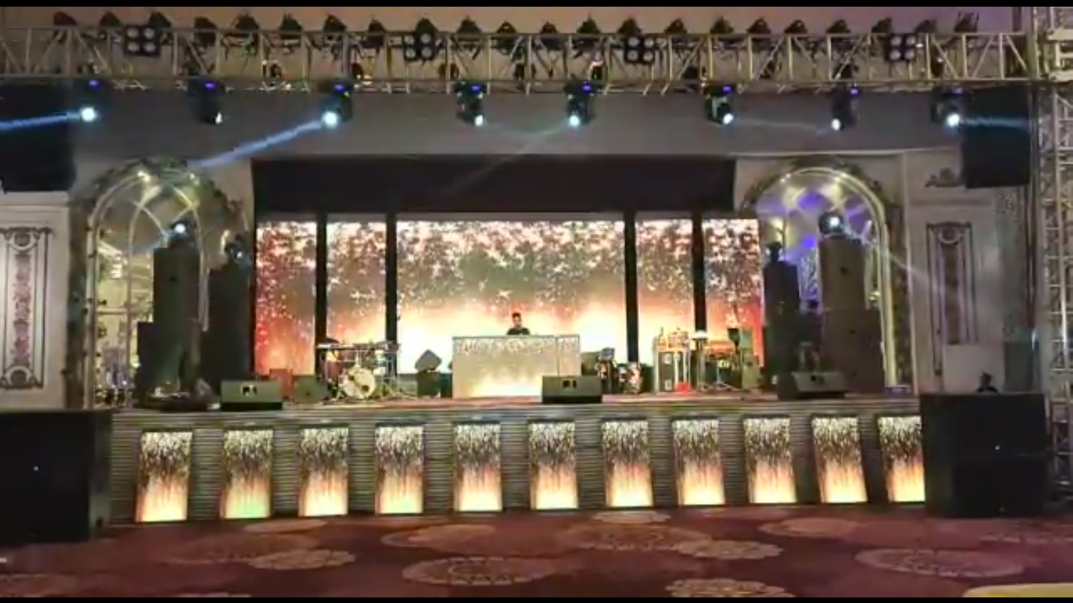
Stage

Slide 4
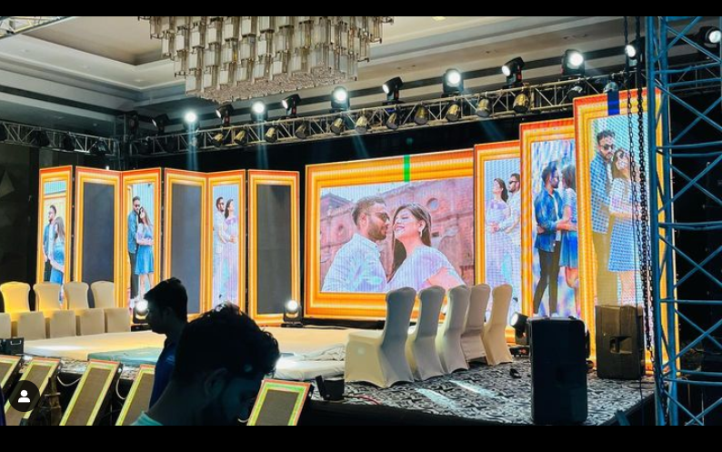

Slide 5
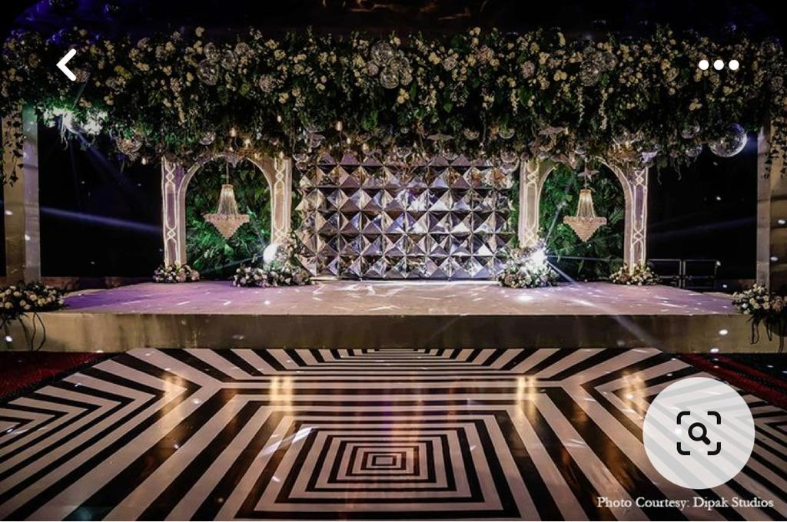
Dance floor, dance floor ceiling

Slide 6
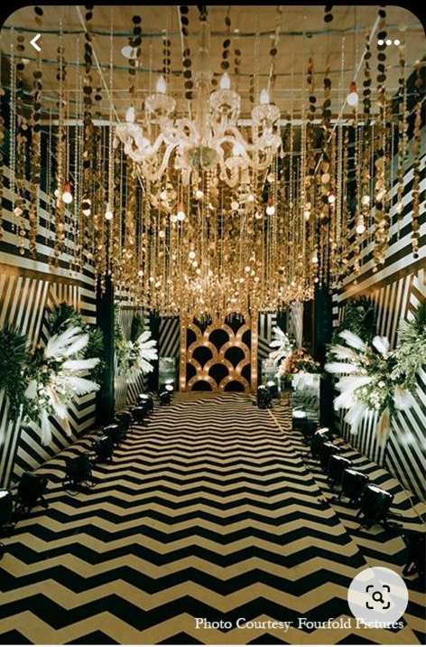
Lets go with this entry passage with a denser ceiling and chandeliers

Slide 7
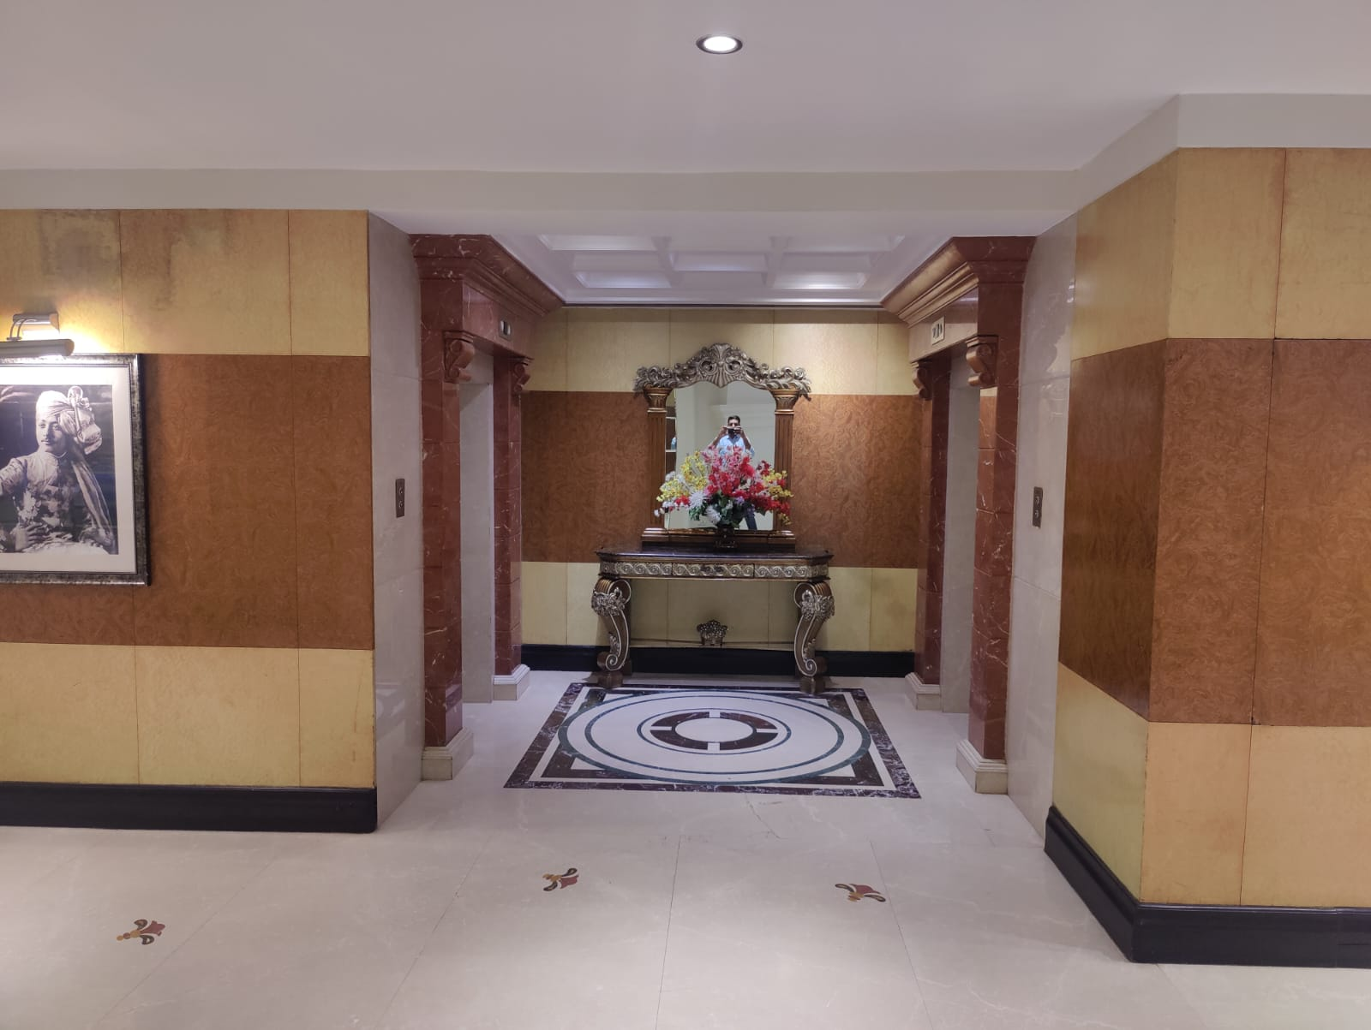
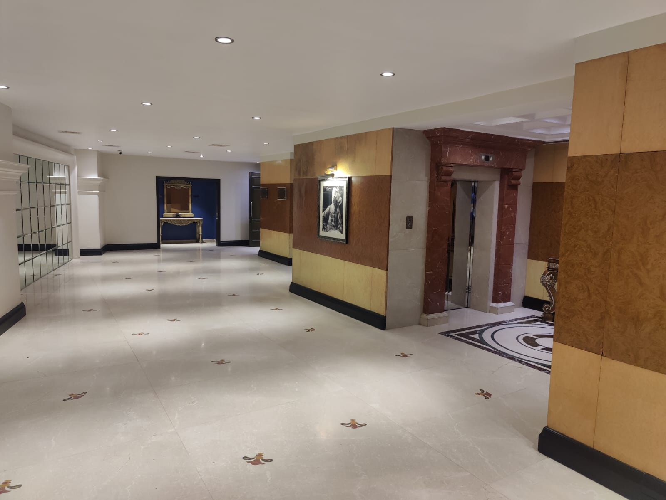

Slide 8
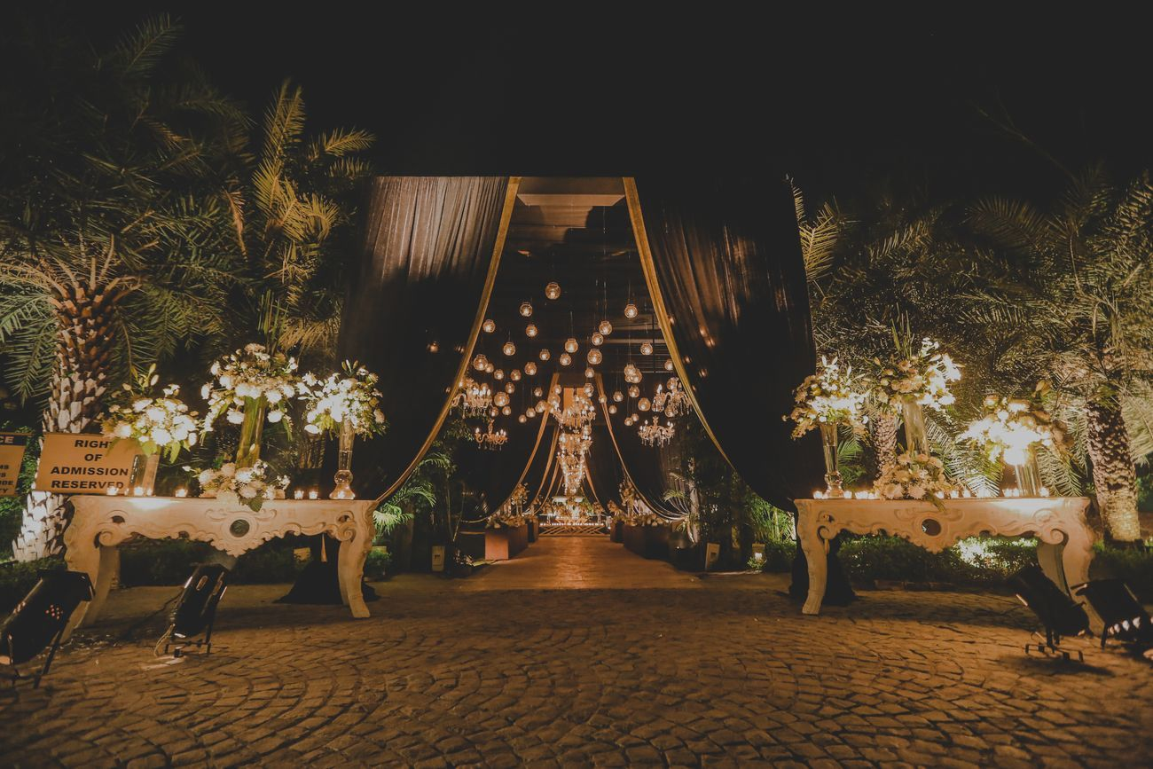
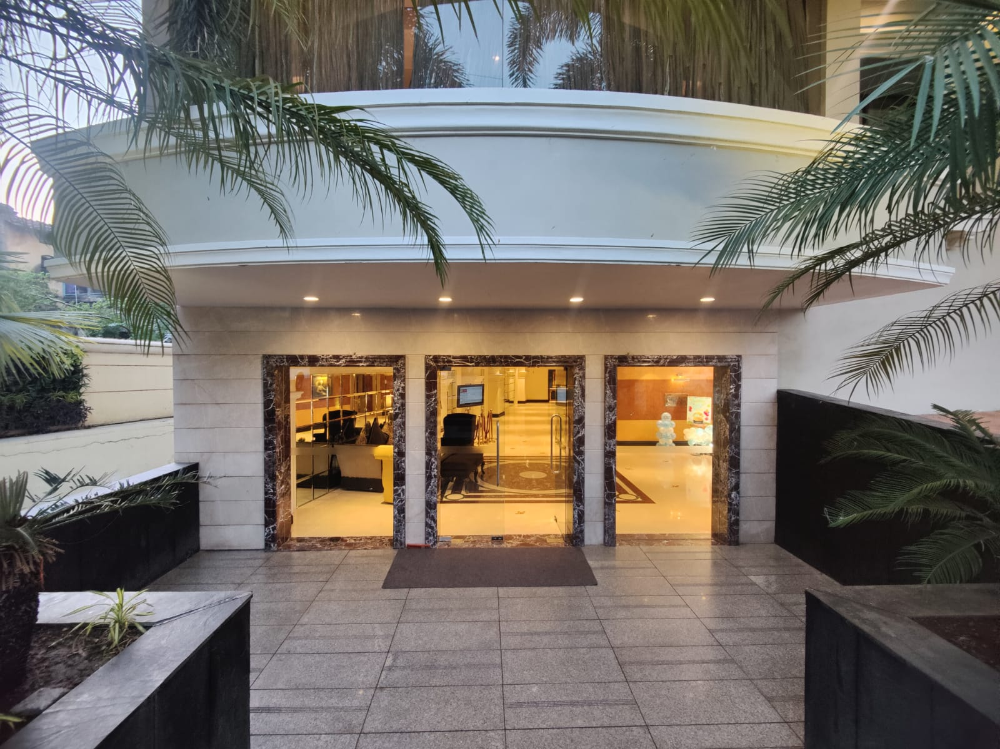
Entry Gate
Entry gate as shown in pic
Instead of Table we can use some other thing for Flower Arrangement.

Slide 9
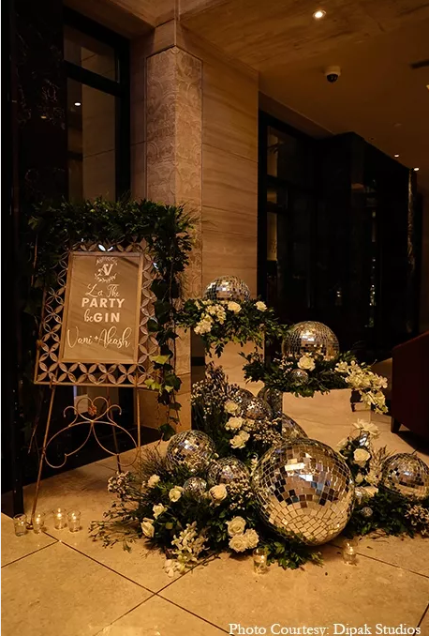
Welcome board

Slide 10
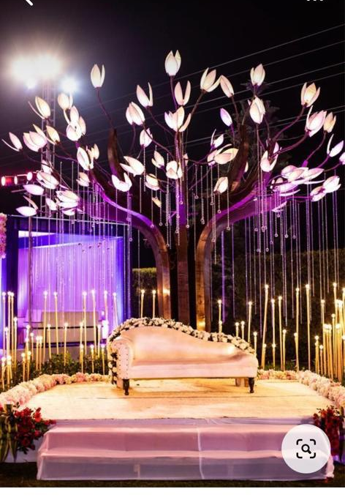
View Cutter

Slide 11
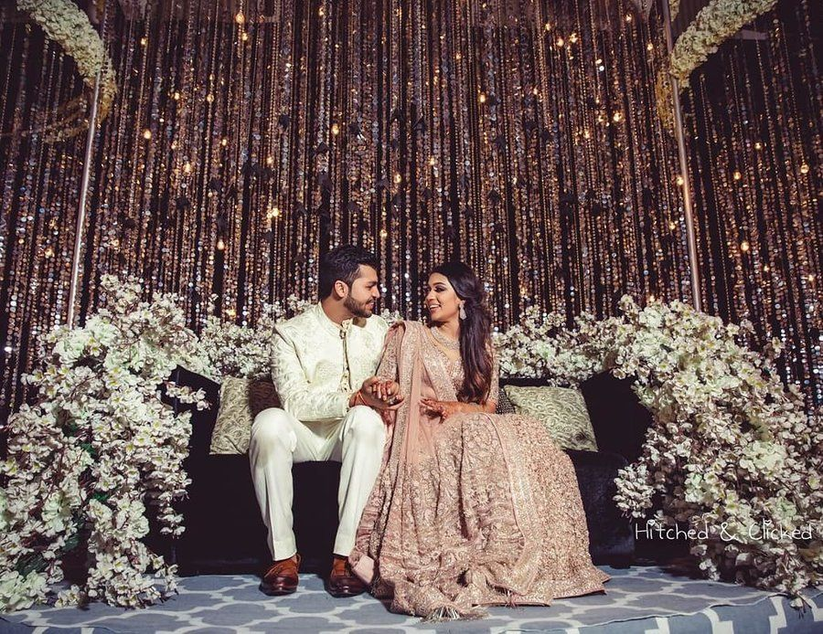
Bride Groom Seating
Only Couch with White flower Arrangements as shown in the picture

Slide 12
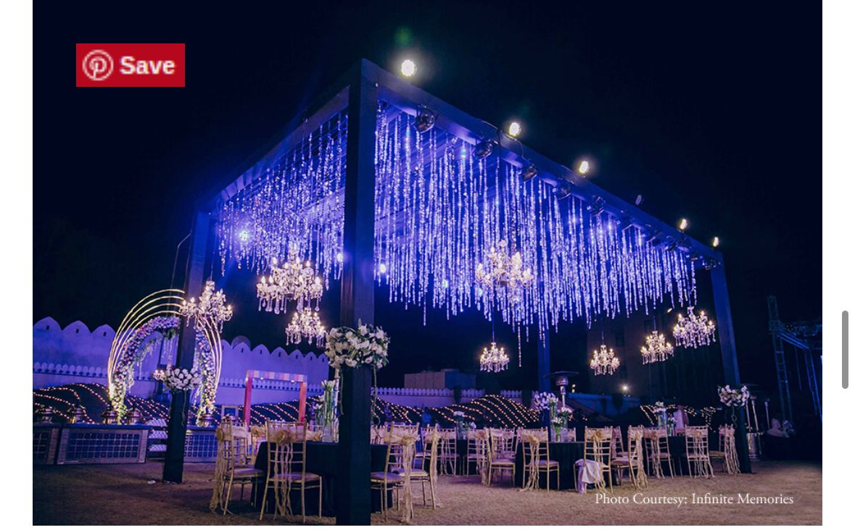
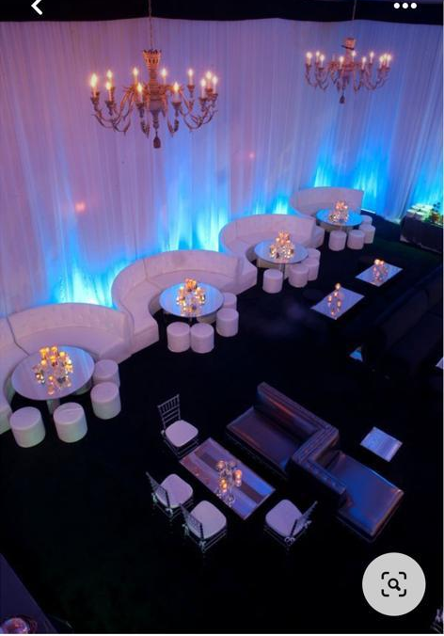
Vip lounge
Lounge sitting

Slide 13
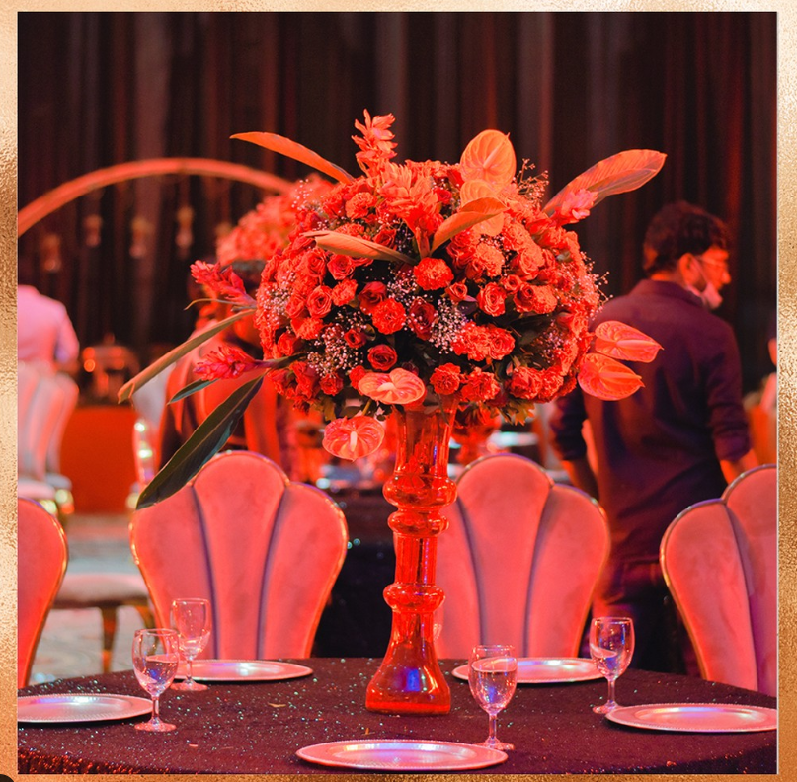
Round Table Centerpieces

Slide 14
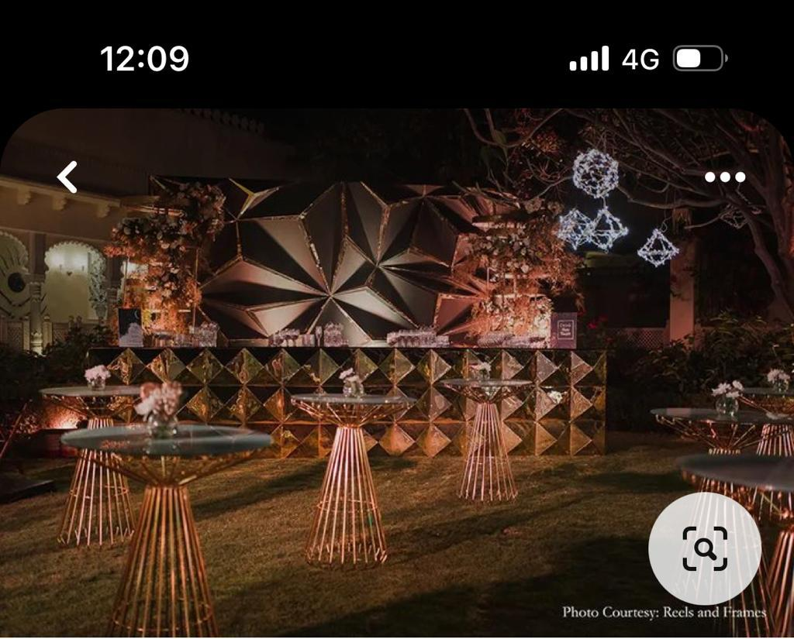
Cocktail bar style, backdrop and bar table

Slide 15
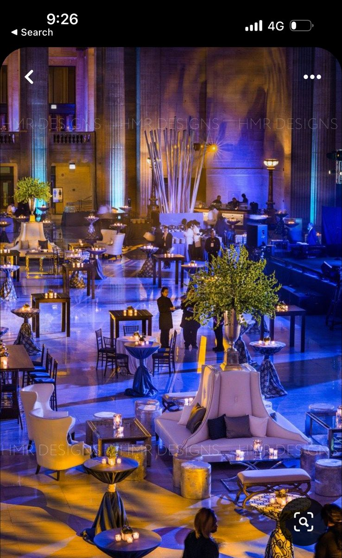
Such Lighting at Tuli From Bottom to Top

Slide 16
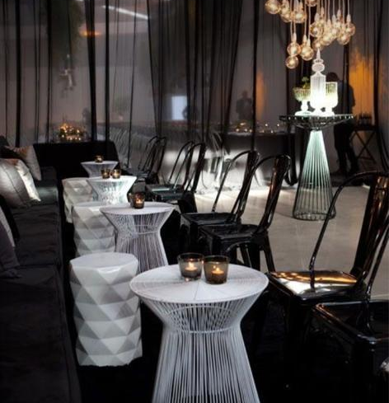
Such Candle Arrangement at Tables

Slide 17
Thank you

